Slide 1



Department of Computer Science and Engineering
ENVIROWATCH: MOBILIZING COMMUNITIES TO SOLVE ENVIROMENTAL CHALLENGES
BHARATH P / 211420104037
BAALA B / 211420104033
MARIA ROBIN ANDREW/ 211420104156
Dr. P. J. Sathish Kumar
Dr. N. Pugazhendi

Slide 2
Abstract
Floods leave a trail of destruction – stagnant water, damaged roads, and broken infrastructure. Traditional methods of assessing damage rely on sensors and reports, which are costly and slow. This text proposes a mobile app to improve disaster recovery.
Residents report problems directly through the app, including pictures. Deep learning, a form of artificial intelligence, analyzes these pictures to identify the issue (e.g., damaged road, stagnant water). This classified information is then sent to the relevant authorities for swift action.
By empowering citizens to report problems and using AI for faster analysis, this app aims to reduce reliance on expensive sensors and accelerate response times. This collaborative approach between residents and authorities can lead to quicker recovery efforts after a flood.

Slide 3
Introduction
The proposed mobile application offers a comprehensive solution to address various environmental issues encountered by communities. Through a user-friendly interface built on Flutter, individuals can effortlessly report problems such as flood water stagnation, damaged roads, electrical pole damage, and accumulated garbage in public areas
Upon submission, the data and images are transmitted to a Flask-based backend, where a deep learning algorithm comes into play.
By harnessing the power of mobile applications, deep learning algorithms, and dedicated departmental websites, the project aims to foster a collaborative environment where proactive community involvement contributes to the sustainable development and maintenance of a cleaner, safer, and more resilient urban landscape.

Slide 4
Objective of the Project
Our objective is to create a comprehensive solution addressing urban environmental challenges. Through a user-friendly mobile application and robust backend infrastructure, citizens can report issues like floodwater stagnation, damaged roads, and garbage accumulation.
Utilizing deep learning algorithms, complaints are categorized and swiftly directed to respective government departments for action. By facilitating citizen engagement, we aim to enhance community participation in environmental stewardship and promote accountability.
Ultimately, our project seeks to foster sustainable urban development by ensuring prompt and effective responses to environmental concerns, contributing to the well-being and resilience of communities while promoting efficient resource management.

Slide 5
Literature Survey
Year | Title | Author | Description | Advantages | Disadvantages
2023 | Research on the classification method of complex snow and ice cover on highway pavement based on image-methodology-temperature fusion | Sen Yang, chengwei Lei, | Classification of complexity of snow and ice cover on winter pavement using combination of different existing models. | Classification of snow and ice cover based upon the thickness and complexity of the cover using meteorological data. | This model is based upon combination of different model which may fail exponentially.
2021 | Video surveillance system for real time flood detection and mobile app for flood alert | K. Priya Menon, L. Kala | An early detection and Warning system detects using video streaming process, and warning information is provided in a mobile app named “FLOOD ALERT” | Provides warning of the flood in the early stage using efficient system. | This system displays the warning in an app and uses video streams as a data for the detection.

Slide 6
Existing System
Manual Reporting Mechanisms: Currently, citizens rely on manual methods such as phone calls, emails, or physical visits to government offices to report environmental issues. This process is cumbersome and time-consuming, leading to underreporting and delays in addressing critical problems.
Fragmented Communication Channels: Communication between citizens and government agencies is often fragmented, with no centralized platform for submitting and tracking complaints. This fragmentation leads to inefficiencies and miscommunications, further delaying the resolution of environmental issues.
Namma Salai: It is a citizen empowerment app for Tamil Nadu, lets you report road issues like potholes directly to the Highways department. Take a picture, submit a complaint, and be part of the solution for safer, smoother roads.

Slide 7
Proposed System
Communities face various environmental challenges. The proposed system proposes a mobile app to bridge the gap between citizens and authorities for faster and more efficient solutions.
Residents report issues like littering or damaged roads directly through the app, including pictures. Artificial intelligence analyzes these images, categorizing them for targeted action.
The app empowers citizens and ensures prompt reporting. Deep learning streamlines the process by automatically routing complaints to the right government department's website for swift resolution. Users can even track the progress of their reports, fostering accountability.
By combining user engagement with AI and departmental collaboration, this app offers a comprehensive approach to environmental management. It promotes transparency, empowers citizens, and paves the way for a more sustainable future.

Slide 8
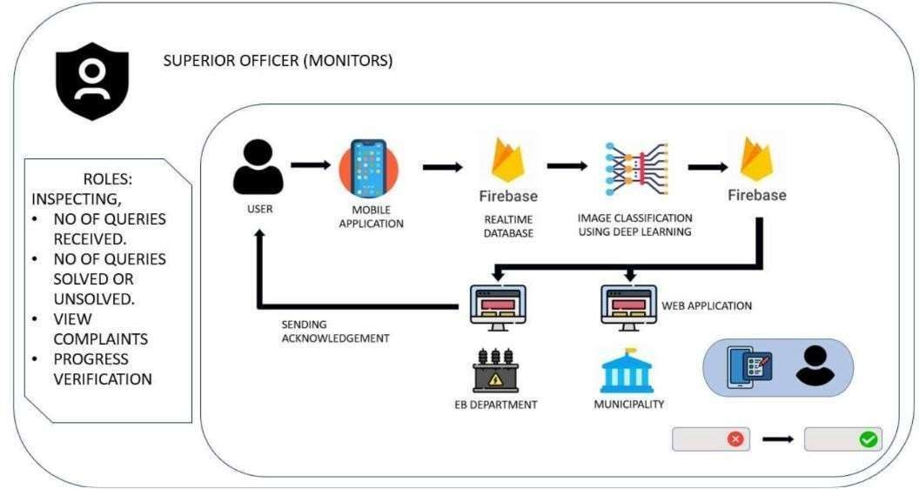
Architecture Diagram

Slide 9
Software & Hardware Requirements
SOFTWARE REQUIREMENT
Operating System: Windows 10
IDE: Visual Studio Code
VS Code Plugins: Flutter, Dart, Python, html , css, javascript
Web framework : Flask
Map API: Google Maps
API Backend: Firebase
HARDWARE REQUIREMENT
Processor: i5 6th gen or higher/ Ryzen 5 1600 or higher
Graphics: Integrated Graphics or any External Graphics
RAM: 8 GB or higher
Proper Internet Connect

Slide 10
Module Description
UI Layer:
Here we do have UI for both user and for respective departments. For user UI in mobile application, for department side deals with websites. Image and message acquisition screen: Here we get photo of the problem prevailing for the user, and if needed message can be posted here. View complaint screen: Officials in their websites, can view those complaints,with images and message posted. View complaint (User) : User can also see his /her complaint posted.
Firebase Realtime Database:
In the proposed project, Firebase Realtime Database is utilized as a backend service to store and manage the data generated by the mobile application. Here's an explanation of how Firebase Realtime Database is used in the project:
Data Storage: Firebase Realtime Database serves as the primary data storage solution for the project. It stores various types of data, including user accounts, complaint reports, complaint sta- tuses, and any other relevant information generated by the application.

Slide 11
Module Description
Real-time Updates: One of the key features of Firebase Realtime Database is its ability to pro- vide real-time updates to connected clients. This means that any changes made to the database are immediately propagated to all connected devices, ensuring that users receive timely updates on the status of their complaints and other relevant information.
Structured Data: Firebase Realtime Database uses a JSON data structure, which allows for flex- ible and efficient data organization. Data is stored in a hierarchical manner, making it easy to re- trieve and manipulate data as needed within the application.
Integration with Flutter: Firebase Realtime Database integrates seamlessly with Flutter, the framework used for developing the mobile application. This integration allows developers to lev- erage Firebase's features and capabilities directly within the Flutter environment, simplifying the development process and enhancing the overall user experience.
Authentication and Security: Firebase Realtime Database offers built-in authentication and secu- rity features, allowing developers to control access to the database based on user roles and per- missions. This ensures that sensitive data is protected and only accessible to authorized users.
Scalability and Performance: Firebase Realtime Database is designed to be highly scalable and performant, capable of handling a large volume of concurrent connections and data transactions. This scalability ensures that the application can accommodate growing user bases and handle spikes in traffic without sacrificing performance.
Offline Support: Firebase Realtime Database provides offline support, allowing users to access and interact with the application even when they are offline. Any changes made to the database while offline are synchronized with the server once an internet connection is restored, ensuring da- ta consistency across devices..

Slide 12
Module Description
Deep learning model:
In the proposed project, a custom deep learning model is developed and trained to classi- fy images of environmental issues captured by users through the mobile application. Here's an explanation of the deep learning model used in the project:
Architecture Design: The custom deep learning model is designed specifically to address the task of classifying environmental issues depicted in images. The architecture of the model is care- fully crafted to effectively capture relevant features from the input images and make accurate pre- dictions about the type of environmental problem depicted in each image.
Convolutional Layers: Convolutional layers play a crucial role in the model's ability to extract spa- tial features from input images. These layers use convolutional filters to perform operations such as edge detection, texture recognition, and feature extraction, allowing the model to identify patterns and structures within the images.
Pooling Layers: Pooling layers are used to reduce the spatial dimensions of the feature maps produced by the convolutional layers while retaining important information. Common pooling operations include max pooling and average pooling, which help to downsample the feature maps and improve computational efficiency.
Fully Connected Layers: Fully connected layers are typically used towards the end of the model architecture to perform classification based on the extracted features. These layers connect every neuron in one layer to every neuron in the next layer, allowing the model to learn complex relationships between the features and make predictions about the class labels.
Activation Functions: Activation functions are applied to the outputs of neurons in the model to in- troduce non-linearity and enable the model to learn complex patterns and relationships within the data. Common activation functions include ReLU (Rectified Linear Unit), sigmoid, and tanh functions

Slide 13
Module Description
Performance:
In the proposed project, the performance module is a crucial component that evaluates the effectiveness and efficiency of the entire system in addressing environmental issues. Here's an explanation of the performance module and its key components:
The performance module is designed for continuous monitoring and improvement of the system over time. By regularly evaluating performance metrics and soliciting user feedback, the system can identify areas for optimization and enhancement, ensuring that it remains effective and responsive in addressing environmental issues within communities. Overall, the performance module serves as a critical tool for assessing and optimizing the effectiveness, efficiency, and user satisfaction of the entire system for managing environmental issues. By incorporating a comprehensive range of performance metrics and feedback mechanisms, the module enables on- going refinement and improvement of the system to better serve the needs of users and communities.

Slide 14
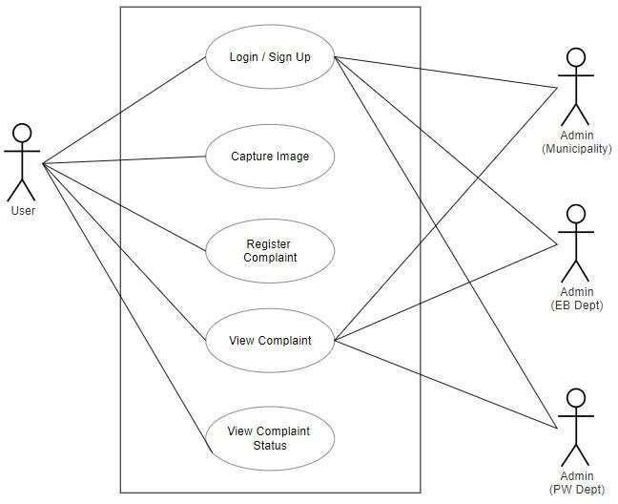
System Design
USE CASE DIAGRAM:

Slide 15
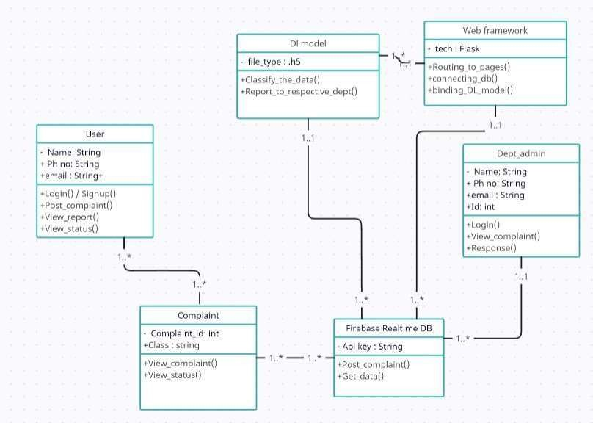
Class Diagram:

Slide 16
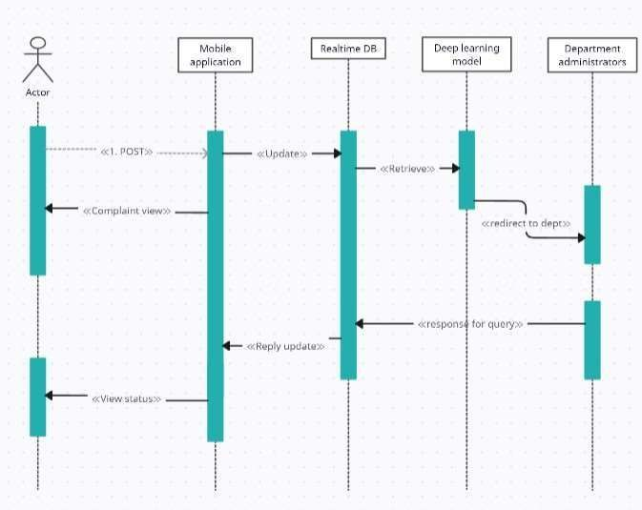
Sequence Diagram:

Slide 17
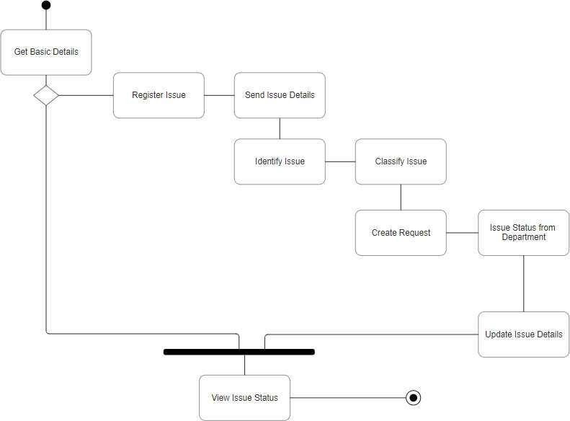
Activity Diagram:

Slide 18
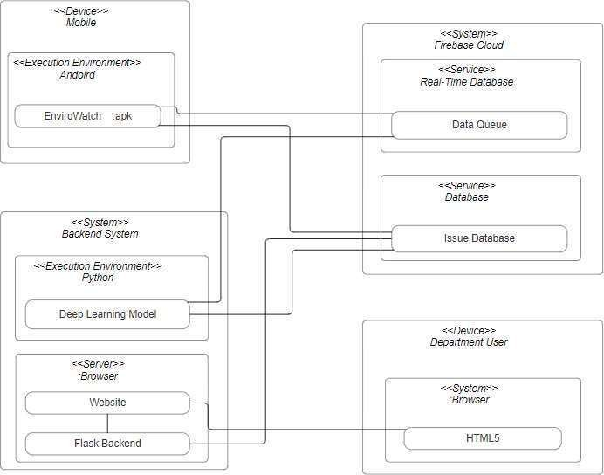
Deployment Diagram:

Slide 19
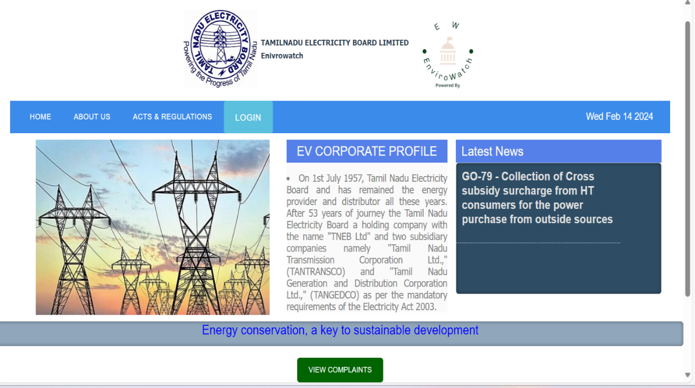
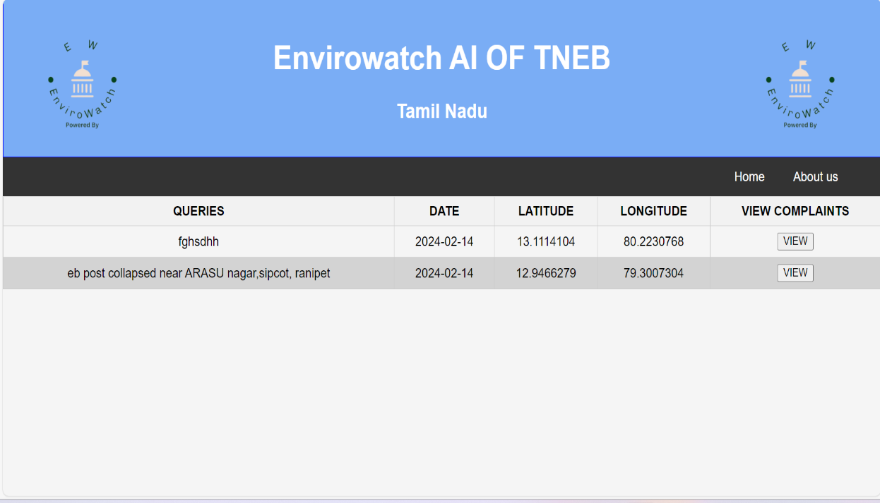
Screenshot

Slide 20
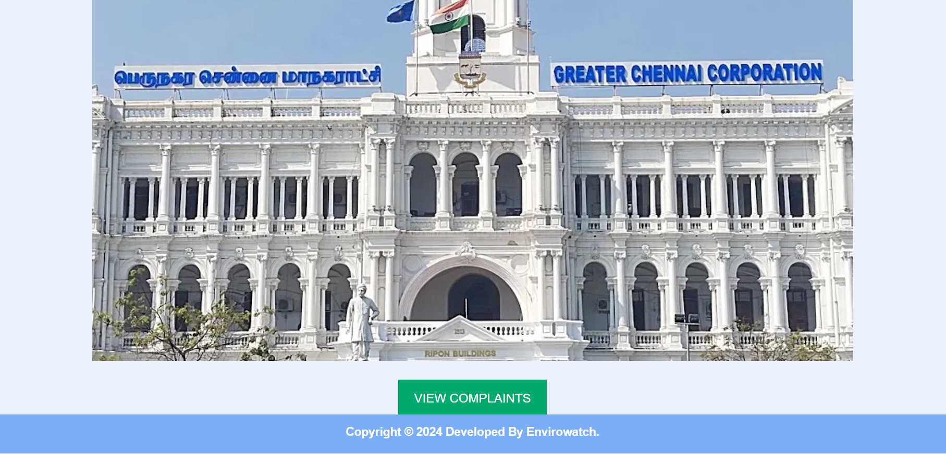


Slide 21
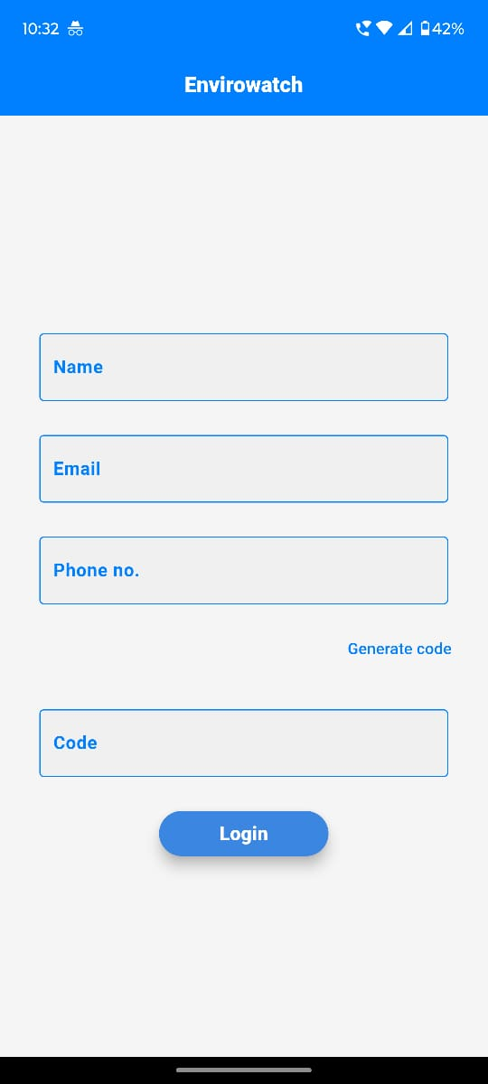
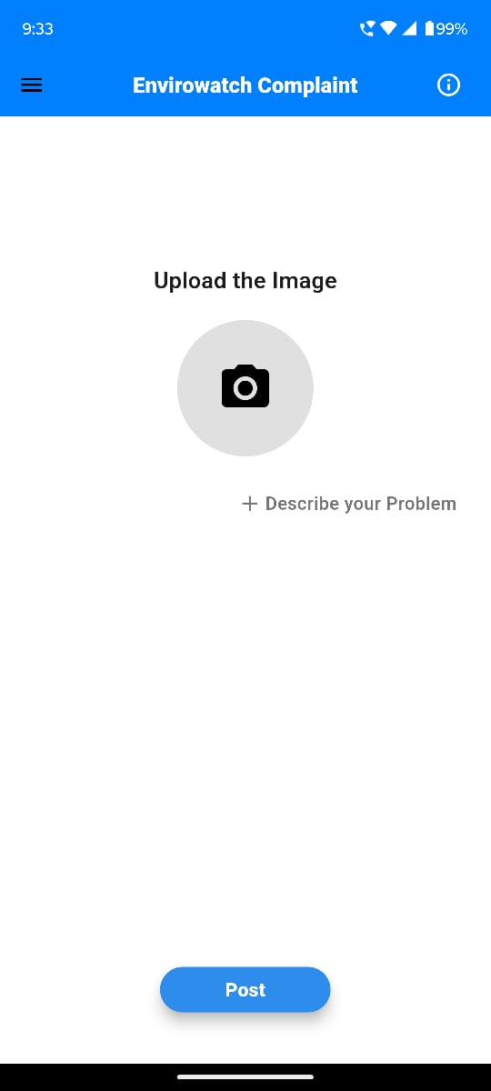
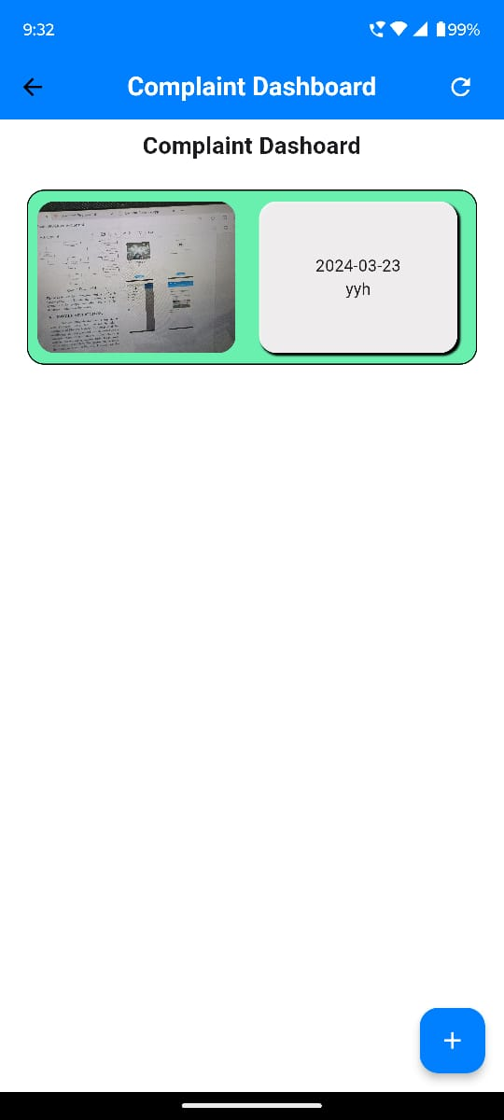
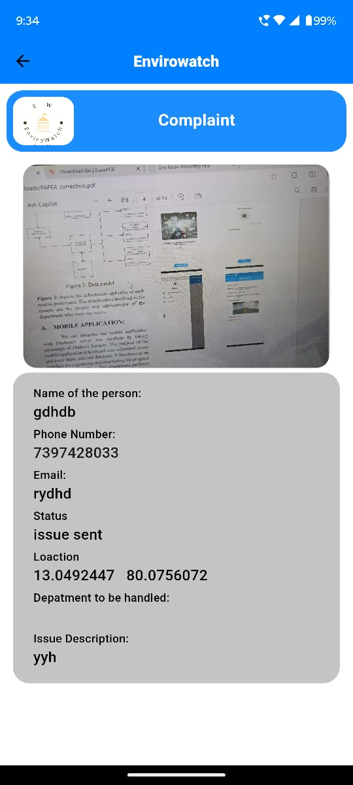

Slide 22
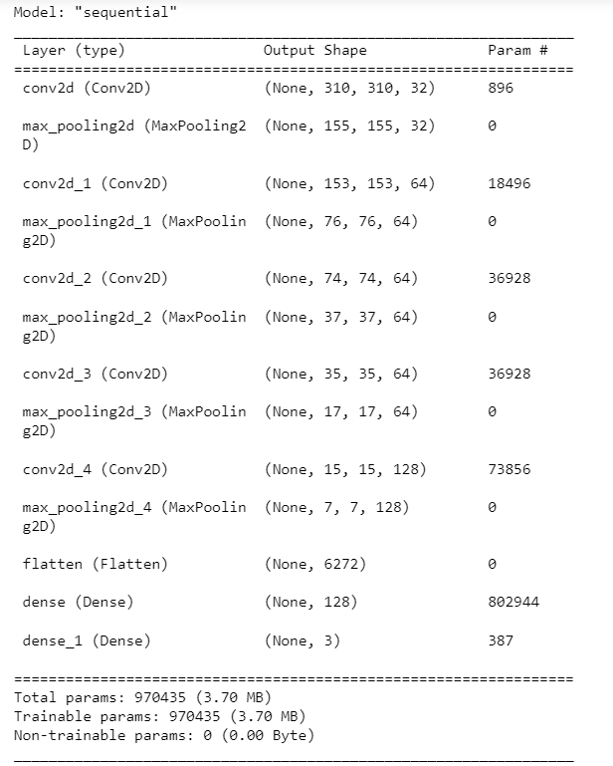

Slide 23
Testing
TEST CASE ID | TESTCASE/ACTION TO BE PERFORMED | EXPECTED RESULT | ACTUAL RESULT | PASS/FAIL
1. | Opening Envirowatch Application | Login page appears | Login page appears | Pass
2. | App version check and Update | Update successful | Update successful | Pass
3. | Enter required sign up Details | Registered successfully | Registered successfully | Pass
4. | Enter login details | Home page appears | Home page appears | Pass
5. | View Issue list | Display list of Issue raised by the user | Display list of Issue raised by the user | Pass
6. | Post image | Image successfully uploaded | Image successfully uploaded | Pass

Slide 24
7. | Enter message | Message Uploaded | Message uploaded | Pass
8. | DL model classification | Classified to wright class | Classified to wright class | Pass
9. | Update the complaint to respective departments in live. | Updated | updated | Pass
10. | Response given by department side. | Reponse posted | Response posted | Pass
11. | View complaint | Complaint Viewed | Complaint viewed | Pass
12. | Get complaint status | Status received | Status received | Pass
13. | Get image from the user to the DL Model | Image received | Image received with in 10 seconds | Pass
14. | Logout from the application | Logout and remove Meta Data | Logout and Clear Meta Data | Pass

Slide 25
Conclusion
In conclusion, our project represents a significant step forward in addressing environmental issues within communities through the integration of technology and citizen engagement. By leveraging a custom deep learning model, real-time communication features, and user-friendly interfaces, we have developed a robust system that empowers citizens to report and address environmental concerns effectivelyThe system includes a comprehensive database storing all user and vehicle data and a robust inventory management system for tracking parts and supplies.
The results demonstrate the system's ability to accurately classify various environmental problems and provide timely updates to users, enhancing transparency and accountability in environmental management. Moving forward, we remain committed to refining and expanding the system to better serve the needs of communities and promote sustainable environmental stewardship.

Slide 26
Feature Enhancement
Enhanced Image Classification: Explore advanced deep learning techniques, such as transfer learning or ensemble models, to further improve the accuracy and robustness of image classification for identifying environmental issues.
Partnerships with NGOs and Businesses: Forge partnerships with non-governmental organiza- tions (NGOs), businesses, and other stakeholders to collaborate on environmental initiatives and leverage additional resources and expertise for sustainable environmental management.
Social Media Integration: Enable seamless integration with social media platforms to allow users to share their environmental concerns and actions with their social networks. This can amplify the reach and impact of the project and encourage broader community involvement.
Crowdsourced Data Validation: Implement mechanisms for crowdsourced data validation, allow- ing users to verify and confirm reported issues. This can enhance the reliability of reported data and reduce the burden on government agencies for manual validation.

Slide 27
Reference Paper/ URL
Namma Salai App website by the government of Tamil Nadu, India to improve the conditions of the problems in the state highway - https://frs.tnhw.pmis.cloud
K. Priya Menon, L. Kala, International Conference on Computing Methodologies and Communication (ICCMC), Video surveillance system for realtime flood detection and mobile app for flood alert, DOI: 10.1109/ICCMC.2017.8282518, IEEE, 2018
Sen Yang, Chengwei Lei, VII IEEE SENSORS JOURNAL, Research on the classification method of complex snow and ice cover on highway pavement based on image-meteorology-temperature fusion, DOI 10.1109/JSEN.2023.3336667, IEEE, 2023
Pankaj Chougale, Vaibhav Yadav, Dr. Anil Gaikwad, 2021, International Research Journal of Modernization in Engineering Technology and Science, Firebase - overview and usage, Volume:03/Issue:12, 2021

Slide 28
End of the Final PTT

